Slide 1
This is the first chapter
Notes:
NEW CHAPTER

Slide 2
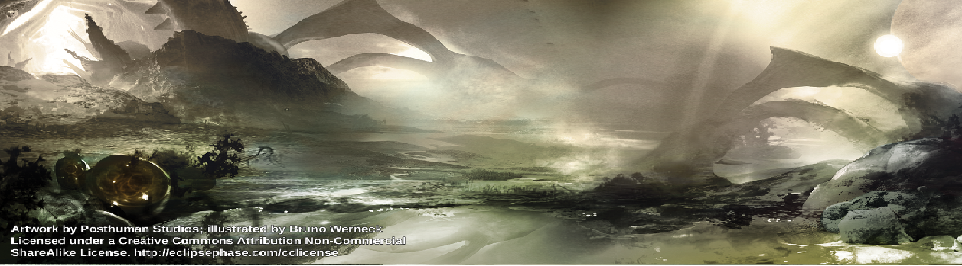
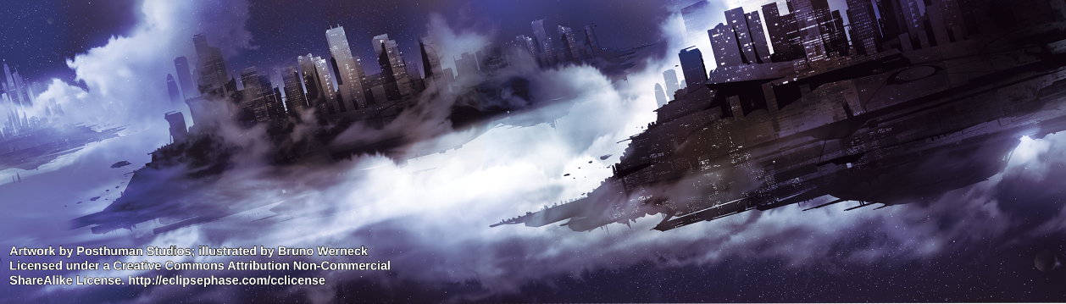
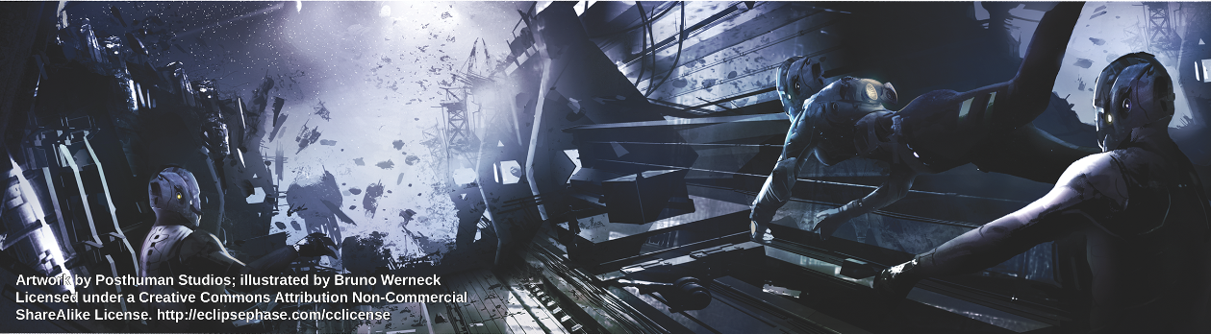
Table of Contents
Src/XMLBits/CH12.png
GM Reference Tables
Src/XMLBits/CH5.png
Character Creation
Src/XMLBits/CH3.png
Sample Adventure
Notes:
Contents Page

Slide 3
This is the second chapter
Notes:
NEW CHAPTER

Slide 4
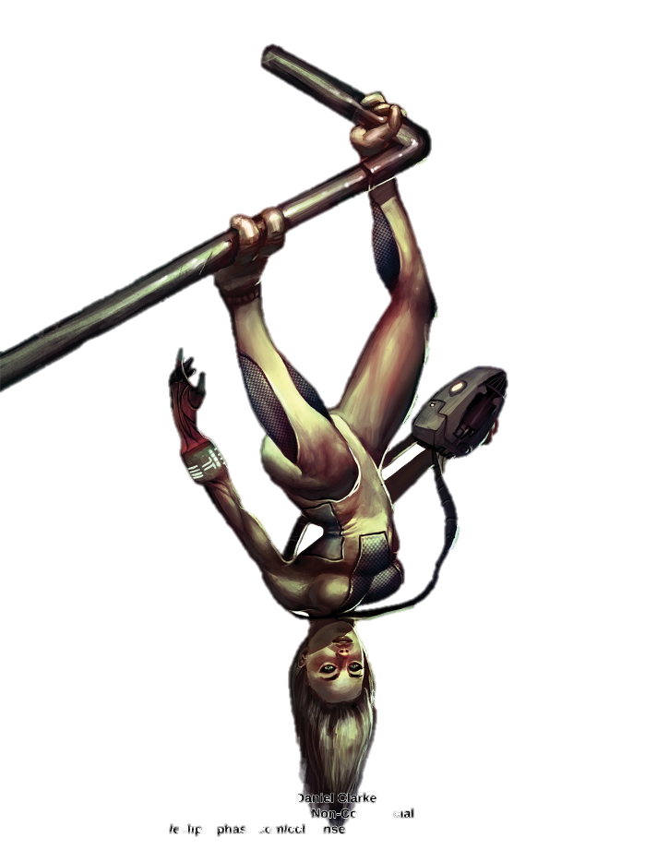
src/XMLBits/ANARCH.png
GM’s Reference
Character Creation
Backgrounds and Factions
Skill List
Traits
Combat and Action
Mesh and Hacking
Notes:
GM’s Reference Tables

Slide 5
CHARACTER CREATION SUMMARY
CUSTOMISATION POINTS
1) Define Character Concept \n2) Choose Background \n3) Choose Faction \n4 ) Spend Free Points \n a) 105 aptitude points \n b) 1 Moxie \n c) 5,000 credits \n d) 50 Rep \n e) Native tongue \n5) Spend Customisation Points \n a) 1,000 CP to spend \n b) Active skill minimum: 400 CP \n c) Knowledge skill minimum: 300 CP \n d) Choose starting Morph \n e) Choose Traits \n6) Purchase Gear \n7) Choose Motivation \n8) Calculate Remaining Stats \n9) Detail the Character
15 CP = 1 Moxie \n10 CP = 1 aptitude point \n5 CP = 1 psi sleight \n5 CP = 1 specialisation \n1 CP = 1 skill point (up to 60) \n2 CP = 1 skill point (61 - 80) \n1 CP = 1,000 \n1 CP = 10 Rep
GEAR COSTS
Trivial = 1-99 credits, 50 credits average \nLow = 100 – 499 credits, 250 credits average \nModerate = 500 – 1,499 credits, 1,000 credits average \nHigh = 1,500 – 9,999 credits, 5,000 credits average \nExpensive = 10,000+ credits, 20,000 credits average
Notes:
GM’s Reference – Character Creation

Slide 6
BACKGROUNDS
FACTIONS
+10 Navigation skill, +20 Pilot Spacecraft skill, +10\n Networking: {Field} skill of your choice \n
Drifter:
Anarchist:
+10 to a skill of your choice, +30 Networking: Autonomists skill\n
Argonaut:
Fall Evacuee:
+10 Pilot Groundcraft skill, +10 Networking: {Field}skill of your\n choice, +1 Moxie, only 2,500 Starting Credit (can still buy credit\n with CP)\n
+10 to two Technical, Academic: {Field}, or Profession: {Field} skills;\n +20 Networking: Scientists\n
Barsoomain:
+10 Freerunning, +10 to one skill of your choice, +20 Networking:\n Autonomists skill\n
Hyperelite:
+10 Protocol skill, +10,000 Credit, +20 Networking: Hypercorps\n skill, may not start with pod, uplift or synthetic morphs\n
Brinker:
+10 Pilot: Spacecraft skill, +10 to a skill of your choice, +20 to a\n Networking: {Field} skill of your choice\n
Infolife:
Criminal:
+10 Intimidation skill, +30 Networking: Criminal skill\n
+30 Interfacing skill, Computer skills (Infosec, Interfacing,\n Programming, Research) cost half as much CP, Real World\n Naiveté trait, Social Stigma (AGI) trait, may not purchase Psi\n trait, Social skills cost twice as much CP\n
Extropian:
+10 Persuasion skill, +20 Networking: Autonomists skill,\n +10 Networking: Hypercorps skill\n
Hypercorp:
Isolate:
+20 to two skills of your choice, -10 starting Rep\n
+10 Protocol skill, +20 Networking: Hypercorps skill, +10 to any\n Networking: {Field} skill\n
Lost:
+20 to two Knowledge skills of your choice, Psi trait (Level 1),\n Mental Disorder (choose two, this includes the one from Psi) trait,\n Social Stigma (Lost) trait, must start with Futura morph\n
Jovian:
+10 to two weapon skills of your choice, +10 Fray, +20 Networking:\n Hypercorps skill, must start with a Flat or Splicer morph, may not\n start with any nanoware or advanced nanotech\n
Lunar Colonist:
+10 Pilot: Groundcraft skill, +10 to one Technical, Academic:\n {Field}, or Profession: {Field} skill of your choice, +20 Networking:\n Hypercorps skill\n
Lunar:
+10 to one Language: {Field} of your choice, +20 Networking: Hypercorps\n skill, +10 Networking: Ecologists skill\n
Martian:
+10 Pilot: Groundcraft skill, +10 to one Technical, Academic:\n {Field}, or Profession: {Field} skill of your choice, +20 Networking:\n Hypercorps skill\n
Mercurial:
+10 to any two skills of your choice, +20 to a Networking: {Field} skill\n of your choice\n
Original Space Colonist:
Scum:
+10 Pilot: Spacecraft or Freefall skill, +10 to a Technical,\n Academic: {Field}, or Profession: {Field} skill of your choice,\n +20 to a Networking: {Field} skill of your choice\n
+10 Freefall skill, +10 to a skill of your choice, +20 Networking:\n Autonomists skill\n
Socialite:
+10 Persuasion skill, +10 Protocol skill, +20 Networking: Media skill,\n May not start with flat, pod, uplift or synthetic morphs\n
Re-Instantiated:
+10 Pilot: Groundcraft skill, +10 to a Networking: {Field} skill of\n your choice, +2 Moxie, Edited Memories trait, 0 Starting Credit\n (can still buy credit with CP)\n
Titanian:
+10 to two Technical or Academic skills of your choice, +20 Networking:\n Autonomists skill\n
Scumborn:
+10 Persuasion or Deception skill, +10 Scrounging skill, +20 Networking:\n Autonomists skill\n
Ultimate:
+10 to two skills of your choice, +20 to a Networking: {Field} skill of\n your choice, may not start with Flat, Splicer, uplift of pod morphs\n
Uplift:
+10 Fray skill, +10 Perception skill, +20 to two Knowledge skills of\n your choice, must choose an uplift morph to start\n
Venusian:
+10 Pilot: Aircraft, +10 to one skill of your choice, +20 Networking:\n Hypercorps skill\n
Notes:
GM’s Reference – Backgrounds & Factions

Slide 7
Skill List
Skill\n
Linked Aptitude\n
Category\n
Skill\n
Linked Aptitude\n
Category\n
Academics: {Field}\nAnimal Handling\nArt: {Field}\nBeam Weapons\nBlades\nClimbing\nClubs\nControl\nDeception\nDemolitions\nDisguise\nExotic Melee Weapon: {Field}\nExotic Ranged Weapon: {Field}\nFlight\nFray\nFree Fall\nFreerunning\nGunnery\n Hardware: {Field}\nImpersonation\nInfiltration\nInfosec\nInterest: {Field}\nInterfacing\nIntimidation\n
COG\nSAV\nINT\nCOO\nSOM\nSOM\nSOM\nWIL (no def)\nSAV\nCOG (no def)\nINT\nSOM\nCOO\nSOM\nREF\nREF\nSOM\nINT\nCOG\nSAV\nCOO\nCOG (no def)\nCOG\nCOG\nSAV\n
Knowledge\n Active, Social\n Knowledge\n Active, Combat\n Active, Combat\n Active, Physical\n Active, Combat\n Active, Mental, Psi\n Active, Social\n Active, Technical\n Active, Physical\n Active, Combat\n Active, Combat\n Active, Physical\n Active, Combat\n Active, Physical\n Active, Physical\n Active, Combat\n Active, Technical\n Active, Social\n Active, Physical\n Active, Technical\n Knowledge\n Active, Technical\n Active, Social\n
Investigation\nKinesics\nKinetic Weapons\nLanguage: {Field}\nMedicine: {Field}\nNavigation\nNetworking: {Field}\nPalming\nPerception\nPersuasion\nPilot: {Field}\nProfession: {Field}\nProgramming\nProtocol\nPsi Assault\nPsychosurgery\nResearch\nScrounging\nSeeker Weapons\nSense\nSpray Weapons\nSwimming\nThrowing Weapons\nUnarmed Combat\n
INT\nSAV\nCOO\nINT\nCOG\nINT\nSAV\nCOO\nINT\nSAV\nREF\nCOG\nCOG\n (no def)\nSAV\nWIL (no def)\nINT\nCOG\nINT\nCOO\nINT (no def)\nCOO\nSOM\nCOO\nSOM\n
Knowledge\n Active, Social\n Knowledge\n Active, Combat\n Active, Combat\n Active, Physical\n Active, Combat\n Active, Mental, Psi\n Active, Social\n Active, Technical\n Active, Physical\n Active, Combat\n Active, Combat\n Active, Physical\n Active, Combat\n Active, Physical\n Active, Physical\n Active, Combat\n Active, Technical\n Active, Social\n Active, Physical\n Active, Technical\n Knowledge\n Active, Technical\n Active, Social\n
Notes:
GM’s Reference – Skill List

Slide 8
Traits
Positive Traits\n
CP Costs\n
Negative Traits\n
CP Costs\n
Adaptability\nAllies\nAmbidextrous\nAnimal Empathy\nBrave\nCommon Sense\nDanger Sense\nDirection Sense\n Eidetic Memory (Ego or Morph Trait)\nExceptional Aptitude\nExpert\nFast Learner\nFirst Impression\nHyper Linguist\nImproved Immune System (Morph Trait)\n Innocuous (Morph Trait)\nLimber (Morph Trait)\n Math Wiz\nNatural Immunity (Morph Trait)\nPain Tolerance (Ego or Morph Trait)\nPatron\nPsi\nPsi Chameleon (Ego or Morph Trait)\nPsi Defense (Ego or Morph Trait)\nRapid Healer (Morph Trait)\nRight at Home\nSecond Skin\nSituational Awareness\nStriking Looks (Morph Trait)\nTough (Morph Trait)\nZoosemiotics\n
10 (Level 1) or 20 (Level 2)\n30\n10\n5\n10\n10\n10\n5\n10\n20\n10\n10\n10\n10\n10 (Level 1) or 20 (Level 2)\n10\n10 (Level 1) or 20 (Level 2)\n10\n10\n10 (Level 1) or 20 (Level 2)\n30\n20 (Level 1) or 25 (Level 2)\n10\n10 (Level 1 or 20 (Level 2)\n10\n10\n15\n10\n10 (Level 1) or 20 (Level 2)\n10 (Level 1), 20 (Level 2) or 30 (Level 3)\n5\n
Addicition (Ego or Morph Trait)\nAged (Morph Trait)\nBad Luck\nBlacklisted\nBlack Mark\nCombat Paralysis\nEdited Memories\nEnemy\nFeeble\nFrail (Morph Trait)\nGenetic Defect (Morph Trait)\nIdentity Crisis\nIlliterate\nImmortality Blues\nImplant Rejection (Morph Trait)\nIncompetent\nLemon (Morph Trait)\nLow Pain Tolerance (Ego or Morph Trait)\nMental Disorder\nMild Allergy (Morph Trait)\nModified Behavior\nMorphing Disorder\nNeural Damage\nNo Cortical Stack (Morph Trait)\nOblivious\nOn the Run\nPsi Vulnerability (Ego or Morph Trait)\nReal World Naiveté\nSevere Allergy\nSlow Learner\nSocial Stigma (Ego or Morph Trait)\nTimid\nUnattractive (Morph Trait)\n Uncanny Valley (Morph Trait)\n Unfit (Morph Trait)\nVR Vertigo\nWeak Immune System (Morph Trait)\nZero-G Nausea (Morph Trait)\n
5 (Minor), 10 (Moderate) or 20 (Major)\n10\n30\n5 or 20\n10 (Level 1), 20 (Level 2) or 30 (Level 3)\n20\n10\n10\n20\n10 (Level 1) or 20 (Level 2)\n 10 or 20\n10\n10\n10\n5 (Level 1) or 15 (Level 2)\n10\n10\n20\n10\n5\n5 (Level 1), 10 (Level 2) or 20 (Level 3)\n10 (Level 1), 20 (Level 2) or 30 (Level 3)\n10\n10\n10\n10\n10\n10\n10 (Uncommon) or 20 (Common)\n10\n10\n10\n10 (Level 1), 20 (Level 2) or 30 (Level 3)\n10\n10 (Level 1) or 20 (Level 2)\n10\n10 (Level 1) or 20 (Level 2)\n10\n
Notes:
GM’s Reference – Traits

Slide 9
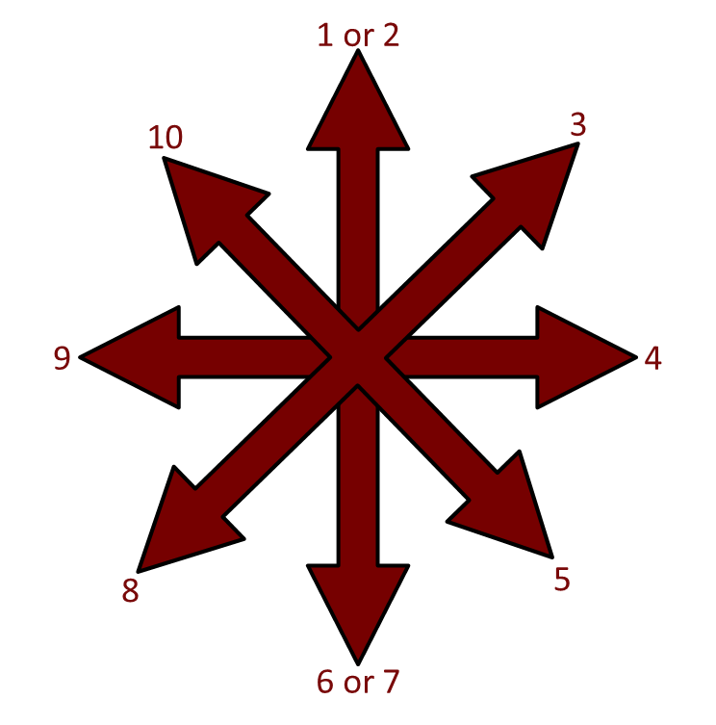
COMBAT SUMMARY
- Combat is handled as an Opposed Test.\n- Attacker rolls attack skill +/- modifiers.\n- Melee: Defender rolls Fray or melee skill +/- modifiers.\n- Ranged: Defender rolls (Fray ÷ 2, round down) +/- modifiers.\n- If attacker succeeds and rolls higher than the defender, the attack hits.\n- Critical hits are armour-defeating (armour does not apply).\n- Armour is reduced by the attack’s Armour Penetration value (AP).\n-The weapon’s damage is reduced by the targets modified Armour rating (unless the attack is armour-defeating).\n-If the damage exceeds the target’s Wound Threshold, a wound is also scored. (If the damage exceeds the Wound Threshold by multiple factors, multiple wounds are inflicted).
ACTION TURN
Step 1: Roll Initiative ((INT + REF) ÷ 5) + 1d10\nStep 2: Begin First Action Phase (Speed 1)\nStep 3: Declare and Resolve Actions\nStep 4: Rotate and Repeat (Speed 2-4)
SCATTER DIAGRAM
Src/XMLBits/SCATTER.png
Notes:
GM’s Reference – Combat & Action

Slide 10
THE HACKING SUMMARY
Tasks\n
Results\n
1. Defeat the Firewall\n2. Bypass Active Security\n a. Hacker Wins with Excellent Success\n b. Hacker Succeeds, Defender Fails\n c. Both Succeed\n d. Defender Succeeds, Hacker Fails
Infosec Task Action (10 minutes)\nVarable Opposed Infosec Test\nHidden Status/Admin Privileges/+30 to all Subversion Tests\nCovert Status\nSpotted Status/Passive Alert/-10 to all Subversion Tests\nLocked Status/Active Alert/-20 to all Subversion Tests
SUBVERSION DIFFICULTIES
MODIFIER\n
TASK\n
\n-0\n\n\n-10\n\n-20\n\n-30
Execute commands, view restricted information, run restricted software, open/close connections to other systems, read/write/copy/delete files, access sensor feeds, access slaved devices\n\nChange system settings, alter log/restricted files\n\nInterfere with system operations, alter sensor /AR input\n\nShut system down, lockout user/muse, launch countermeasures at others
Notes:
GM’s Reference – Mesh & Hacking

Slide 11
This is the third chapter
Notes:
NEW CHAPTER

Slide 12
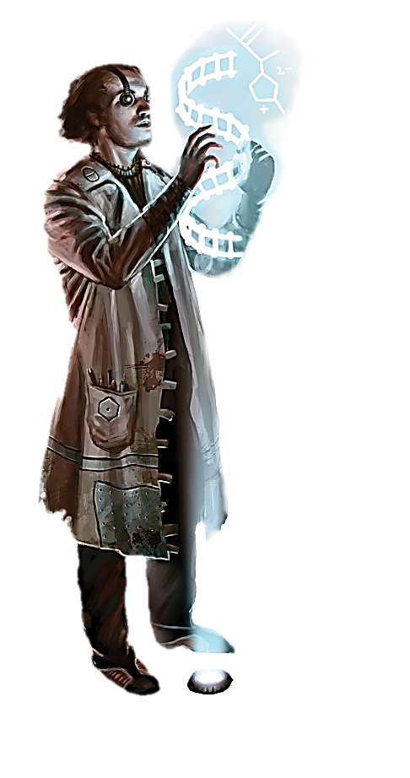
Src/XMLBits/BRINKE.png
Character Creation
1. Define Character Concept\n\n
2. Choose Background\n\n
3. Choose Faction\n\n
4. Spend Free Points\n\n
5. Spend Customisation Points\n\n
6. Purchase Gear\n\n
7. Choose Motivations\n\n
8. Calculate Remaining Stats\n\n
9. Detail the Character\n\n
Notes:
Character creation

Slide 13
CHARACTER CONCEPT
Deciding what/who you want to play before you make the character is usually the best route. Pack a simple archetype that fits your character and work from there. Do you want to play an explorer? Someone sneaky, like a spy of thief? Someone cerebral, like a scientist? A hardened criminal or ex-cop? Or do you prefer to be a rabble-rousing agitator? You can also start with a personality type and choose an associated profession. If you want to be a social butterfly who excels at manipulating people, you can play a media personality, blogger or party-going socialite. Perhaps you’d prefer a bottomed-out reject with substance abuse problems, in which case an ex-merc or former hypercapitalist who lost their fortune and family during the Fall might fit. How about an energetic, live-life-to-the-fullest, must-see-it-all character? Then a habitat freerunner or professional gatecrasher might be what you’re looking for.\nMake sure to check in with the other players and try to create a character that’s complementary to the rest of the team – preferably one who provides some skill-set the group lacks. Why create a research archeologist if someone else is already set on playing one, especially when the team lacks a good combat specialist or async? On the other hand, if your team is going to be running an alien archaeological expedition, then having more than one researcher (each with distinct areas of expertise) might not be bad.\nOnce you have the basic concept, try to fill it in with a few more details, making it into a one-sentence summary. If you started with the concept of “xenosociologist”, expand it to “open-minded amateur linguist and expert xenosociologist who is fascinated by alien cultures, collects Factor kitsch, has a high tolerance for ‘yuck factors’ and whose best friends tend to be uplifts and AIs”. This will give you a few more details around which you can focus the character’s strengths and weaknesses.
On to CHOOSE BACKGROUND
Notes:
Character Concept

Slide 14
CHOOSE BACKGROUND
The first step to creating your character is to choose a background. Was you character born on Earth before the Fall/ Were they raised on a habitat commune? Or did they start existence as a disembodied AI?\nYou must choose one of the backgrounds for you character from the list to the right. Choose wisely, as each background may provide your character with certain skills, traits, limitations or other characteristics to start with. Keep in mind that your background is where you came from, not where you are now. It is the past, whereas your faction represents whom your character is currently aligned with. Your future, of course, is yours to make.\nThe background options presented below cover a wide selection of transhumanity, but they cannot cover every possibility. If your gamemaster allows it, you work with them to develop a background that is not included on this list, using these as guide-lines to keep it balanced.
Drifter\n
Fall Evacuee\n
Hyperelite\n
Infolife\n
Isolate\n
Lost\n
Lunar Colonist\n
Martian\n
Original Space Colonist\n
Re-Instantiated\n
Scumborn\n
Uplift\n
On to CHOOSE FACTION
Notes:
Choose Background

Slide 15
DRIFTER
You were raised with a social grouping that remained on the move throughout the Sol system. This could have been free traders, pirates, asteroid farmers, scavengers or just migrant workers. You are used to roaming space travel between habitats and stations.
ADVANTAGES
DISADVANTAGES
COMMON MORPHS
- +10 Navigation skill\n- +20 Pilot: Spacecraft skill\n- +10 Networking: {Field} skill of your choice
None
All, especially Bouncers and Hibernoids
Back to BACKGROUNDS
On to CHOOSE FACTION
Notes:
Drifter

Slide 16
FALL EVACUEE
You were born and raised on Earth and evacuated during the horrors of the Fall, leaving your old life (and possibly your friends, family and loved ones) behind you. You were lucky enough to survive with your body intact and continue to make a life for yourself out in the system.
ADVANTAGES
DISADVANTAGES
COMMON MORPHS
- +10 Pilot: Groundcraft skill\n- +10 Networking: {Field} skill of your choice\n- +1 Moxie
- Only 2,500 Starting Credit (can still by credit with CP)
Flats, Splicers
Back to BACKGROUNDS
On to CHOOSE FACTION
Notes:
Fall Evacuee

Slide 17
HYPERELITE
You are privileged to have been raised as part of the immortal upper class that rules many inner system habitats and hypercorps. You were pampered with wealth and influence that most people can only dream of.
ADVANTAGES
DISADVANTAGES
COMMON MORPHS
- +10 Protocol skill\n- +10,000 Credit\n- +20 Networking: Hypercorps skill
- May not start with flat, splicer or any pod, uplift or synthetic morphs
Exalts, Sylphs
Back to BACKGROUNDS
On to CHOOSE FACTION
Notes:
Hyperelite

Slide 18
INFOLIFE
You entered existence as a digital consciousness – an artificial general intelligence (AGI). Your very existence is illegal in certain habitats (a legacy of those who place the Fall at the feet of rampant AIs). Unlike the seed AIs responsible for their Fall, your capacity for self –improvement is limited, though you do have full autonomy
ADVANTAGES
DISADVANTAGES
COMMON MORPHS
- +30 Interfacing skill\n- Computer skills (Infosec, Interfacing, Programming, Research) bought with Customisation Points are half price.
- Real World Naivete trait\n- Social Stigma (AGI) trait\n- May not purchase Psi trait\n- Social skills bought with Customisation Points are double price
Infomorphs, Synthetic morphs
Back to BACKGROUNDS
On to CHOOSE FACTION
Notes:
Infolife

Slide 19
ISOLATE
You were raised as part of a self-exiled grouping on the fringes of the system. Whether raised as part of religious group, cult, social experiment, anti-tech cell or group that just wanted to be isolated, you spent most if not all of your upbringing isolated from other factions.
ADVANTAGES
DISADVANTAGES
COMMON MORPHS
- +20 to two skills of your choice
- -10 starting Rep
All
Back to BACKGROUNDS
On to CHOOSE FACTION
Notes:
Isolate

Slide 20
LOST
You are a legacy of one of the most infamous debacles since the Fall. As a member of the “Lost generation”, you went through an accelerated-growth childhood, somehow surviving where others of your kind died, went insane or were persecuted. Your background is a social stigma, but it does provide you with certain advantages… and burdens.
ADVANTAGES
DISADVANTAGES
COMMON MORPHS
- +20 to two Knowledge skills of your choice\n- Psi trait (Level 1)
- Mental Disorder (choose two, this includes the one from Psi) trait\n- Social Stigma (Lost) trait\n- Must start with Futura morph
Futura
Back to BACKGROUNDS
On to CHOOSE FACTION
Notes:
Lost

Slide 21
LUNAR COLONIST
You experienced your childhood in one of the cramped dome cities or underground stations on Luna, Earth’s moon. You had a ringside seat to the Fall of Earth.
ADVANTAGES
DISADVANTAGES
COMMON MORPHS
- +10 Pilot: Groundcraft skill\n- +10 to one Technical, Academic: {Field} or Profession: {Field} skill of your choice\n- +20 Networking: Hypercorps skill
None
Flats, Splicers
Back to BACKGROUNDS
On to CHOOSE FACTION
Notes:
Lunar Colonist

Slide 22
MARTIAN
You were raised in a station on or above Mars, now the most populated planet in the system. Your home town may or may not have survived the Fall.
ADVANTAGES
DISADVANTAGES
COMMON MORPHS
- +10 Pilot: Groundcraft skill\n- +10 to one Technical, Acdemic: {Field} skill or Profession: {Field} skill of your choice\n- +20 Networking: Hypercorps skill
None
Flats, Splicers and Rusters
Back to BACKGROUNDS
On to CHOOSE FACTION
Notes:
Martian

Slide 23
ORIGINAL SPACE COLONIST
You or your parents were part of the first “generations” of colonists/workers sent out from Earth to stake a claim in space, so you are familiar with the cramped confines of spaceflight and life aboard older stations and habitats. As a “Zero-one g” (zero-gravity, first-gen), you were never part of the elite. People from your background typically have some sort of specialized tech training as vacworkers or habtechs
ADVANTAGES
DISADVANTAGES
COMMON MORPHS
- +10 Pilot: Spacecraft or Freefall skill\n- +10 to a Technical, Academic: {Field} or Profession: {Field} skill of your choice\n- +20 to a Networking: {Field} skill of your choice
None
All. Use of exotic morphs is common
Back to BACKGROUNDS
On to CHOOSE FACTION
Notes:
Original Space Colonist

Slide 24
RE-INSTANTIATED
You were born and raised on Earth, but you did not survive the Fall. All that you know is that your body died there, but your backup was transmitted offworld and you were one of the lucky few to have been re-instantiated with a new morph. You may have spent years in dead storage, simulspace or as an infomorph slave.
ADVANTAGES
DISADVANTAGES
COMMON MORPHS
- +10 Pilot: Groundcraft skill\n- +10 to a Networking: {Field} skill of your choice\n- +2 Moxie
- Edited Memories trait\n- 0 Starting Credit (can still by Credit with CP)
Cases, Infomorphs, Synths
Back to BACKGROUNDS
On to CHOOSE FACTION
Notes:
Re-Instantiated

Slide 25
SCUMBORN
You were raised in the nomadic and chaotic lifestyle common to scum barges
ADVANTAGES
DISADVANTAGES
COMMON MORPHS
- +10 Persuasion or Deception skill\n- +10 Scrounging skill\n- +20 Networking: Autonomists skill
None
All, especially Bouncers
Back to BACKGROUNDS
On to CHOOSE FACTION
Notes:
Scumborn

Slide 26
UPLIFT
You are not even human. You were born as an uplifted animal: chimpanzee, gorilla, orang-utan, parrot, raven, crow or octopus.
ADVANTAGES
DISADVANTAGES
COMMON MORPHS
- +10 Fray skill\n- +10 Perception skill\n- +20 to two Knowledge skills of your choice
- Must choose an uplift morph to start
Neo-Avian, Neo-Hominid, Octomorph
Back to BACKGROUNDS
On to CHOOSE FACTION
Notes:
Uplift

Slide 27
CHOOSE FACTION
After choosing your background, you now choose which primary faction your character belongs to. This faction most likely represents the grouping that controls you character’s current home habitat/station and to which your character holds allegiance, but this need not be the case. You may be a dissident member of your faction, living among them but opposing some (or all) of their core memes and perhaps agitating for change. Whatever the case, your faction defines how your character represents themself in the struggle between ideologies post-fall.\nYou must choose one of the factions listed on the right. Like your character's background, it will provide your character with certain skills, traits, limitations or other characteristics.\nThe factions presented here outline the most numerous and influential among transhumanity, but others may also exist. At your gamemaster’s discretion, you may develop another starting faction with them not included on this list.
Anarchist\n
Argonaut\n
Barsoomain\n
Brinker\n
Criminal\n
Extropian\n
Hypercorp\n
Jovian\n
Lunar\n
Mercurial\n
Scum\n
Socialite\n
Titanian\n
Ultimate\n
Venusian\n
On to SPEND FREE POINTS
Notes:
Choose Faction

Slide 28
ANACHIST
You are opposed to hierarchy, favouring flat forms of social organisation and directly democratic decision-making. You believe power is always corrupting and everyone should have a say in the decisions that affect their lives. According to the primitive and restrictive policies of the inner system and Jovian Junta, this makes you an irresponsible hoodlum at best and a terrorist at worst. In your opinion, that’s comedy coming from governments that keep their populations in line with economic oppression and threats of violence.
ADVANTAGES
DISADVANTAGES
COMMON MORPHS
- +10 to a skill of your choice\n- +30 Networking: Autonomists skill
None
All
Back to FACTIONS
On to SPEND FREE POINTS
Notes:
Anachist

Slide 29
ARGONAUT
You are part of a scientific technoprogressive movement that seeks to solve transhumanity’s injustices and inequalities with technology. You support universal access to technology and healthcare, open-source models of production, morphological freedom and democratisation. You try to avoid factionalism and divisive politics, seeing transhumanity’s splintering as a hindrance to its perpetuation.
ADVANTAGES
DISADVANTAGES
COMMON MORPHS
- +10 to two Technical, Academic: {Field}, Profession: {Field} skills\n- +20 Networking: Scientists
None
All
Back to FACTIONS
On to SPEND FREE POINTS
Notes:
Argonaut

Slide 30
BARSOOMIAN
You call the Martian outback and wilds your home. You are a “redneck”, a lower-class Martian from the rural areas that often find themselves in conflict with the policies and goals of the hypercorp domes and the Tharsis League.
ADVANTAGES
DISADVANTAGES
COMMON MORPHS
- +10 Freerunning skill\n- +10 to one skill of your choice\n- +20 Networking: Autonomists skill
None
Cases, Flats, Rusters, Splicers, Synths
Back to FACTIONS
On to SPEND FREE POINTS
Notes:
Barsoomain

Slide 31
BRINKER
You or your faction is reluctant to deal with the rest of transhumanity and the various goings-on in the rest of the system. Your particular grouping may have sought out self-imposed isolation to pursue their own interests or they may have been exiled for their unpopular beliefs. Or you may simply be a loner who prefers the vast emptiness of space to socialising with others. You might be a religious cultist, a primitivist, a utopian or something altogether uninterested in transhumanity.
ADVANTAGES
DISADVANTAGES
COMMON MORPHS
- +10 Pilot: Spacecraft skill\n- +10 to a skill of your choice\n- +20 to a Networking: {Field} skill of your choice
None
All
Back to FACTIONS
On to SPEND FREE POINTS
Notes:
Brinker

Slide 32
CRIMINAL
You are involved with the crime-oriented underworld. You may work with one of the Sol sytem’s major factions – triads, the Night Cartel, the ID Crew, Nine Lives, Pax Familae – or one of the smaller, local operators with a big stake in a specific habitat. You might be a vetted member-for-life, a reluctant recruit or just a freelancer looking for the next gig.
ADVANTAGES
DISADVANTAGES
COMMON MORPHS
- +10 Intimidation skill\n- +30 Networking: Criminal skill
None
All
Back to FACTIONS
On to SPEND FREE POINTS
Notes:
Criminal

Slide 33
EXTROPIAN
You are an anarchistic supporter of the free market and private property. You oppose government and favour a system where security and legal matters are handled by private competitors. Whether you consider yourself an anarcho-capitalist or a mutualist (a difference only other Extropians can figure out), you occupy a middle ground between the hypercorps and autonomists, dealing with both and yet trusted by neither.
ADVANTAGES
DISADVANTAGES
COMMON MORPHS
- +10 Persuasion skill\n- +20 Networking: Autonomists skill\n- +10 Networking: Hypercorps skill
None
All
Back to FACTIONS
On to SPEND FREE POINTS
Notes:
Extropian

Slide 34
HYPERCORP
You hail from a habitat controlled by the hypercorps. You might be a hypercapitalist entrepreneur, a hedonistic socialite or a lowly vacworker, but you accept that certain liberties must be sacrificed for security and freedom.
ADVANTAGES
DISADVANTAGES
COMMON MORPHS
- +10 Protocol skill\n- +20 Networking: Hypercorps skill\n- +10 to any Networking: {Field} skill
None
Exalts, Olympians, Splicers, Sylphs
Back to FACTIONS
On to SPEND FREE POINTS
Notes:
Hypercorp

Slide 35
JOVIAN
Your faction is noted for its authoritarian regime, bioconservative ideologies and militaristic tendencies. Where you come from technology is not to be trusted and Humans need to be protected from themselves. To ensure its survival, Humanity must be able to defend itself and unfettered growth must be checked
ADVANTAGES
DISADVANTAGES
COMMON MORPHS
- +10 to two weapon skills of your choice\n- +10 Fray\n- +20 Networking: Hypercorps skill
- Must start with a Flat or Splicer morph\n- May not start with any nanoware or advanced nanotech
Flats and Splicers
Back to FACTIONS
On to SPEND FREE POINTS
Notes:
Jovian

Slide 36
LUNAR
You hail from Luna, the original off-Earth colony world. Now overpopulated and in decline, Luna is one of the few places where people still cling to old-Earth ethnic and national identities. Your home is also within sight of Earth, a constant reminder that encourages many “Loonies” to be reclaimers, deploring the hypercorp interdiction and arguing that you have a right to return to Earth, terraform it and re-establish it as a living homeworld.
ADVANTAGES
DISADVANTAGES
COMMON MORPHS
- +10 to one Language: {Field} of your choice\n- +20 Networking: Hypercorps skill\n- +10 Networking: Ecologists skill
None
Cases, Exalts, Flats, Splicers, Synths
Back to FACTIONS
On to SPEND FREE POINTS
Notes:
Lunar

Slide 37
MERCURIAL
Your faction has no interest in co-opting their true natures in order to become more “human”. You might be an AGI that does not necessarily intertwine its destiny with transhumanity or an uplift that seeks to preserve and promote non-human life (or at least your own species). You might even be an infomorph or posthuman who has strayed so far from transhuman interests and values that you now consider yourself to be forging a unique new path of life.
ADVANTAGES
DISADVANTAGES
COMMON MORPHS
- +10 to any two skills of your choice\n- +20 to a Networking: {Field} skill of your choice
None
Infomorphs, Synths, Uplift morphs
Back to FACTIONS
On to SPEND FREE POINTS
Notes:
Mercurial

Slide 38
SCUM
This is the future we’ve been waiting for and you’re going to enjoy it to the max. A paradigm shift has occurred and while everyone else is catching up, your faction embraces and revels in it. There is no more want, no more death, no more limits on what you can be. The scum have immersed themselves in a new way of life, changing themselves as they see fit, trying out new experiences and pushing the boundaries wherever they can… and fuck anyone who can’t deal with that.
ADVANTAGES
DISADVANTAGES
COMMON MORPHS
- +10 Freefall skill\n- +10 to a skill of your choice\n- +20 Networking: Autonomists skill
None
All
Back to FACTIONS
On to SPEND FREE POINTS
Notes:
Scum

Slide 39
SOCIALITE
You are a member of the inner system glitterati, the media-saturated social cliques that set trends, spread memes and make or break lives with whispers, innuendo and backroom deals. You are simultaneously an icon and a devout follower. Culture isn’t just your life, it’s your weapon of choice.
ADVANTAGES
DISADVANTAGES
COMMON MORPHS
- +10 Persuasion skill\n- +10 Protocol skill\n- +20 Networking: Media skill
- May not start with Flat, Pod, Uplift or Synthetic morphs
Exalts, Olympians, Sylphs
Back to FACTIONS
On to SPEND FREE POINTS
Notes:
Socialite

Slide 40
TITANIAN
You are a participant in the Titanian Commonwealth’s socialist cyberdemocracy. Unlike other autonomist projects, Titanian joint efforts have assembled some impressive infrastructure projects as approved by the Titanian Plurality and pursued by state-owned microcorps.
ADVANTAGES
DISADVANTAGES
COMMON MORPHS
- +10 to two Technical or Academic skills of your choice\n- +20 Networking: Autonomists skill
None
All
Back to FACTIONS
On to SPEND FREE POINTS
Notes:
Titanian

Slide 41
ULTIMATE
Your faction sees the potential in transhumanity’s future and looks back upon the rest of transhumanity as weak and hedonistic. Transhumanity is set to take the next evolotuionary step and it’s time for transhumans to be redesigned to the best of our capabilities.
ADVANTAGES
DISADVANTAGES
COMMON MORPHS
- +10 to two skills of your choice\n- +20 to a Networking: {Field} skill of your choice
- May not start with Flat, Splicer, Uplift or Pod morphs
Exalts, Remades
Back to FACTIONS
On to SPEND FREE POINTS
Notes:
Ultimate

Slide 42
VENUSIAN
You are a supporter of the Morningstar Confederation of Venusian aerostats, resentful of the growing influence of the Planitary Consortium and other entrenched and conservative inner system powers. You see your faction’s ascension as a chance to reform the old guard ways of inner system politics.
ADVANTAGES
DISADVANTAGES
COMMON MORPHS
- +10 Pilot: Aircraft skill\n- +10 to one skill of your choice\n- +20 Networking: Hypercorps skill
None
Cases, Exalts, Mentons, Splicers, Sylphs, Synths
Back to FACTIONS
On to SPEND FREE POINTS
Notes:
Venusian

Slide 43
SPEND FREE POINTS
Each starting character receives an equal number of free points for things like rep and aptitudes. These free points are just the start for building your character, so don’t fret if you can’t get certain scores as high as you like. In the next stage of character creation, you will gain additional points with which you can customise your character.
STARTING APTITUDES
STARTING MOXIE
Your character receives 105 points to distribute among their 7 aptitudes: Cognition, Coordination, Intuition, Reflexes, Savvy, Somatics and Willpower. (That breaks down to an average of 15 per aptitude, so it may be easiest to give each 15 and then adjust accordingly, raising some and lowering others). Each aptitude must be given at least 5 points and no aptitude may be raised higher than 30. Note that certain morphs may also put a cap on how high you can raise your aptitudes.
Every character starts off with a Moxie stat of 1.
CREDIT
All characters are given 5,000 credits with which to purchase gear during character creation, unless you have the Fall Evacuee or Re-Instantiated background (in which case you start with 2,500 and 0 credits, respectively.
REP
NATIVE TONGUE
Your character isn’t a complete newbie. You get 50 rep points to divide between the reputation networks of your choice.
Every character receives their natural Language skill at a rating of 70 + INT for free. This skill may be raised with CP.
On to SPEND CUSTOMISATION POINTS

Slide 44
SPEND CUSTOMISATION POINTS
Now that you have the basics of your character fleshed out, you can spend additional Customisation Points (CP) to fine-tune your character. Each character is given 1,000 CP, which may be used to increase aptitudes, buy skills, acquire more Moxie, buy more credit, elevate your Rep or purchase positive traits. You may also take neative traits in order to get even more CP with which to customise your character. This customisation process should be used to tweak your character and specialise them in the ways you desire.\nIf a gamemaster seeks a different level of gameplay, they can adjust this CP amount. If the gamemaster wants a scenario where the starting characters are younger or less experienced, they can lower the CP to 800 or even 700.
Anarchist\n
Argonaut\n
Barsoomain\n
Brinker\n
Criminal\n
Extropian\n
Hypercorp\n
Jovian\n
Lunar\n
Mercurial\n
Scum\n
Socialite\n
Titanian\n
Ultimate\n
Venusian\n
On to PURCHASE GEAR

Slide 47
This is the fourth chapter
Notes:
NEW CHAPTER

Slide 48
Sample Adventure

